Slide 1
U n i v e r s i t y O f B a s r a h
Al - z a h r a a M e d i c a l C o l l e g e
Ministry of higher Education and Scientific Researches
Academic year 2021- 2022
2nd year (S3)
Module: Musculoskeletal system (MSK)
Session No. 7
Lecture: 2
Date: 30th November 2021
Osteology and radiology of lower limb
Module staff:
Dr. Falih Waheed Hashim Dr. Nawal Mustafa
Dr. Waleed Jawad
Dr. Ahmed Ibrahim Habib Dr. Ahmed Hazim Dahamm
Dr. Raed Jasim Chasib Dr. Rafid Mousa
Dr. Ahmed Khalaf Dr. Khalil I. Sadiq
Dr. Mohammed Baqir Abbas
Moore, K.L. and Dalley, A.F. Clinically Oriented Anatomy, 8thEdition. LipincottWlliamsand Wilkins, 2018.

Slide 2
U n i v e r s i t y O f B a s r a h
Al - z a h r a a M e d i c a l C o l l e g e
Ministry of higher Education and Scientific Researches
Module Learning objectives= 11
Name the bones of the pelvic girdle and the lower limb on the skeleton
Identify these bones on plain x-rays
To identify the important surface bony landmarks in the hip region and in the lower limb

Slide 3
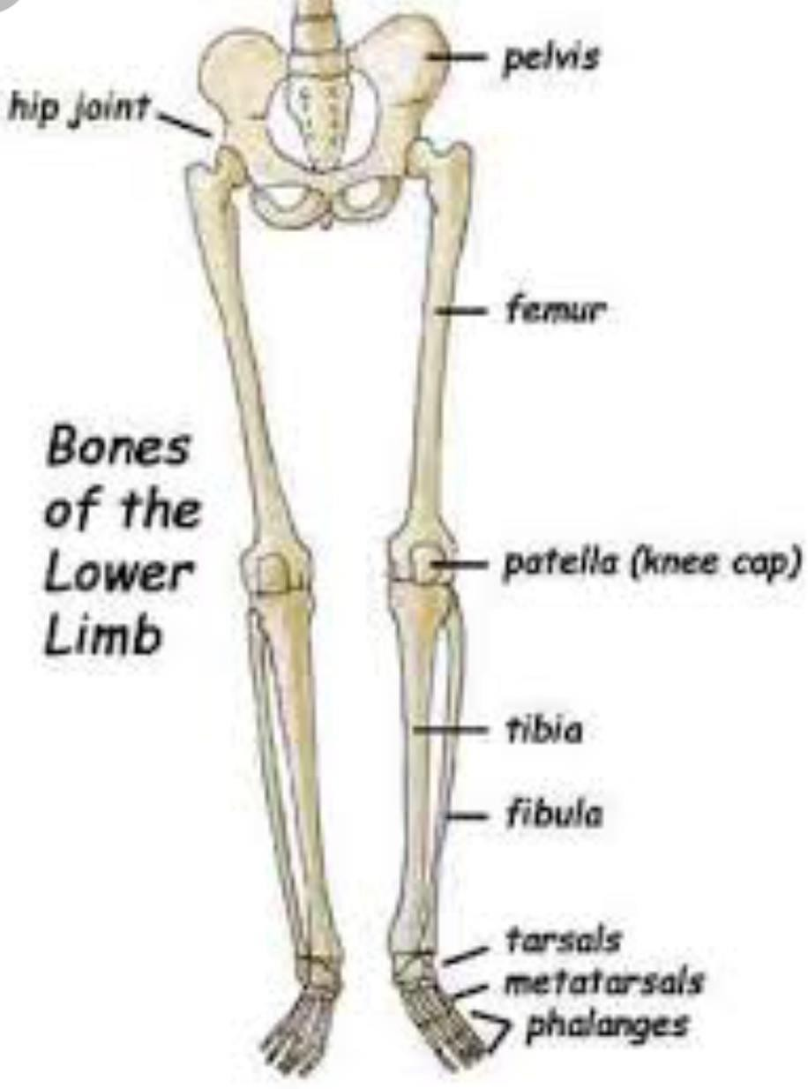
U n i v e r s i t y O f B a s r a h
Al - z a h r a a M e d i c a l C o l l e g e
Ministry of higher Education and Scientific Researches
Bones of Lower Limb
Hip bone
Femur
Patella
Tibia
Fibula
Foot (tarsal, metatarsals, phalanges)

Slide 4
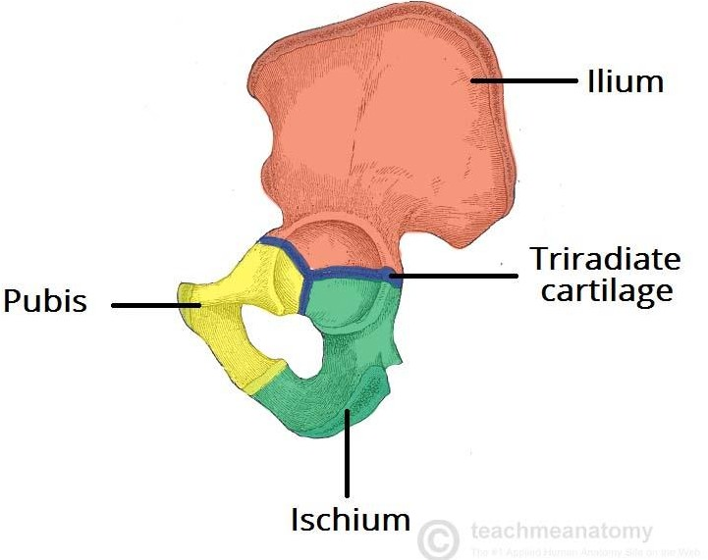
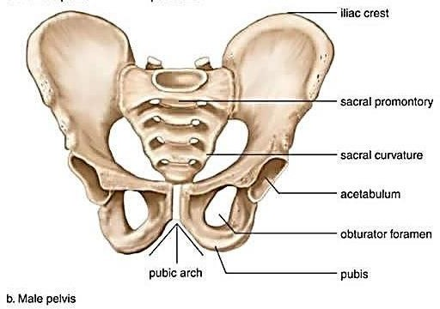
Hip bone composed from:
Ilium
Ischium
Pubis
Pelvis composed from:
Two hip bones
Sacrum

Slide 5
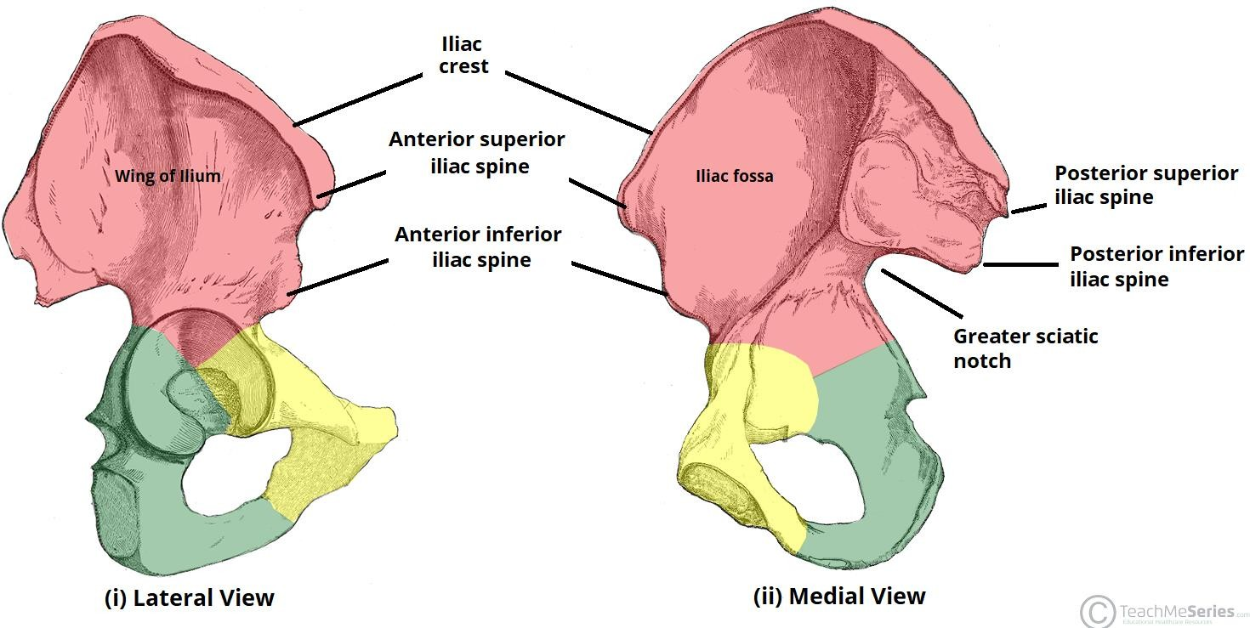
Ilium bone
Iliac crest: the thick, upper margin
Iliac fossa: anterior smooth surface
Anterior superior/ Anterior inferior Iliac spine
Posterior superior/ Posterior inferior Iliac spine
Greater sciatic notch/ Lesser sciatic notch

Slide 6
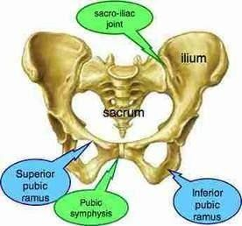
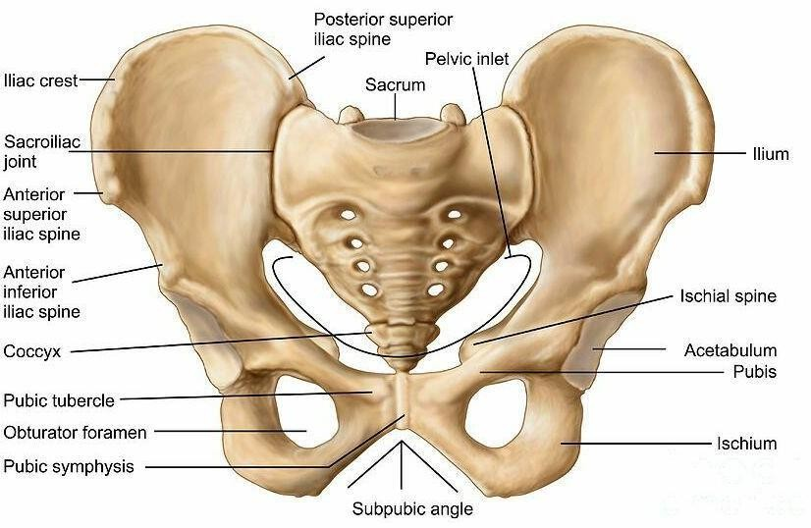
Pubic bone:
Superior/inferior ramus
Pubic tubercle
Pubic symphysis
Pubic arch

Slide 7
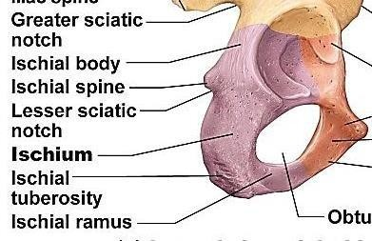
Ischium bone:
Ischial tuberosity: site for attachment of hamstring muscles
Ischial spine: site for ligament attachment.
Obturator foramen: the only “hole” or opening for nerves/blood vessels.
Ischial ramus: point of connection with inferior ramus of pubis.

Slide 8
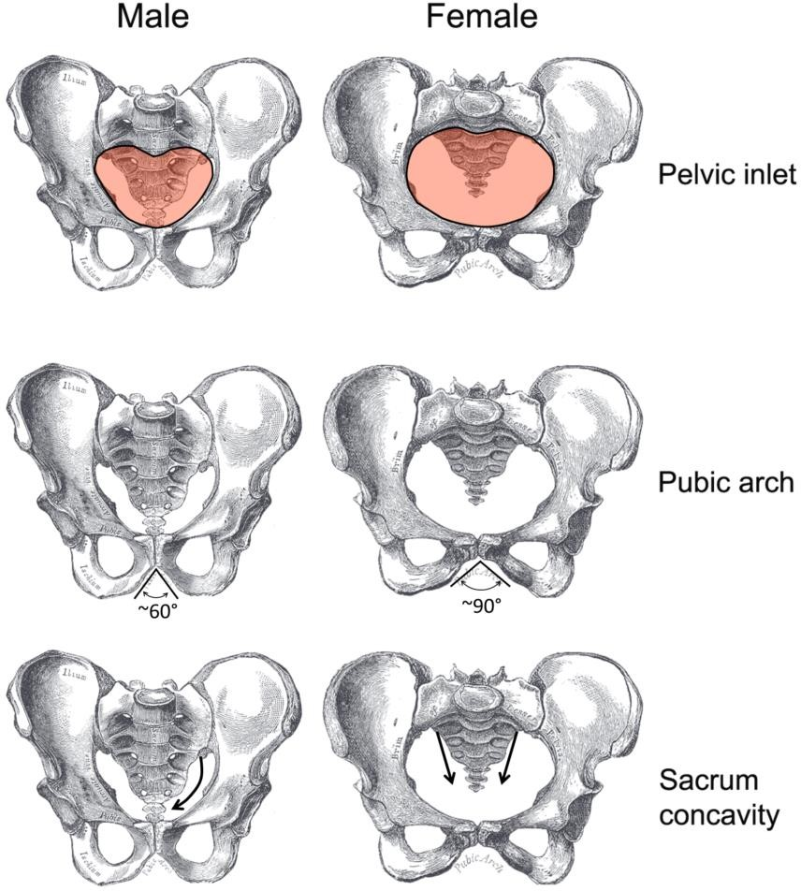

Slide 9
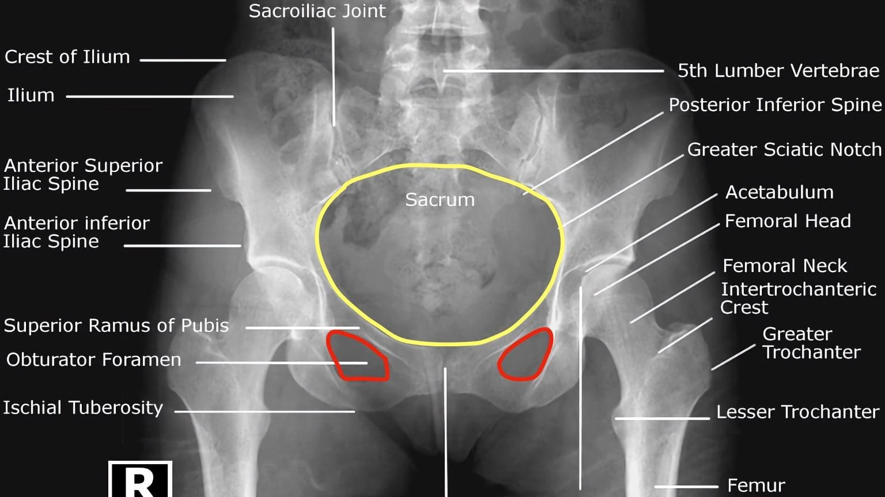

Slide 10
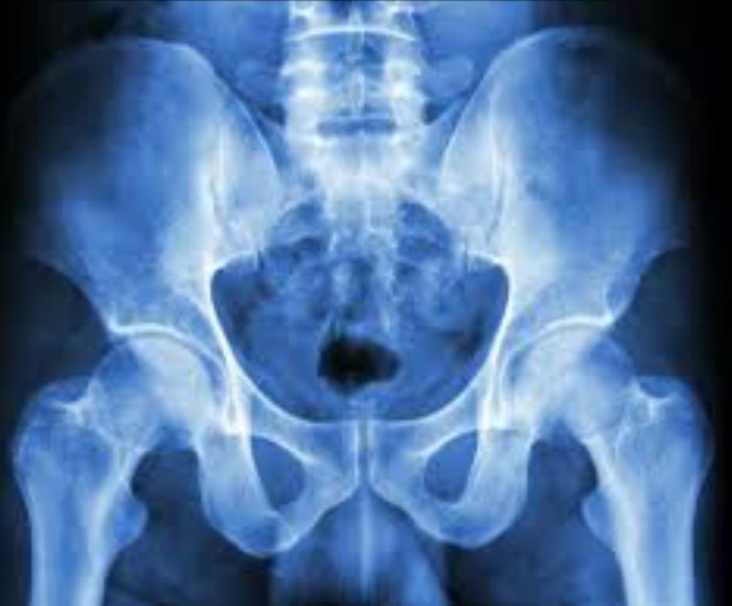
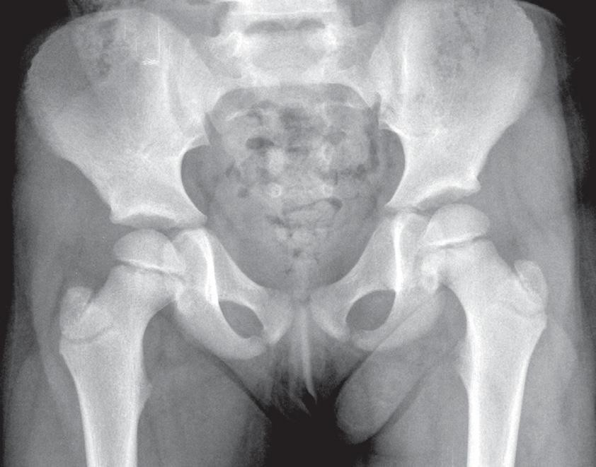
U n i v e r s i t y O f B a s r a h
Al - z a h r a a M e d i c a l C o l l e g e
Ministry of higher Education and Scientific Researches
What is the difference?

Slide 11
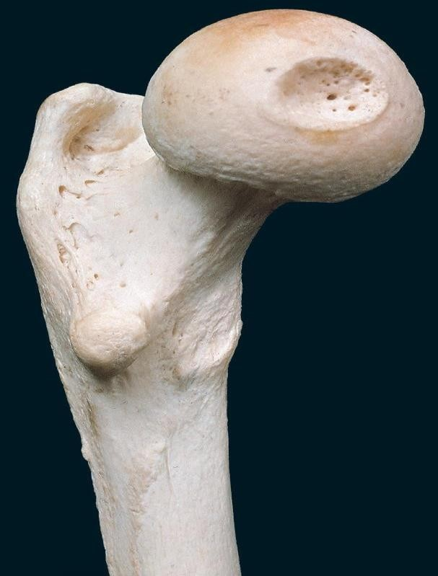
U n i v e r s i t y O f B a s r a h
Al - z a h r a a M e d i c a l C o l l e g e
Femur bone:
Ministry of higher Education and Scientific Researches
Is the Single bone of
the thigh
Is the largest, longest,
and strongest bone in
the body.
The head of the femur:
articulates with the acetabulum of the hip.
Fovea capitis: small, pit
shaped which teres.
depression in the ligamentum

Slide 12
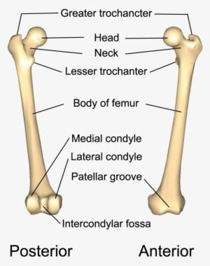
U n i v e r s i t y O f B a s r a h
Al - z a h r a a M e d i c a l C o l l e g e
Ministry of higher Education and Scientific Researches
Femur
Femoral head
Fovea capitis
Femoral neck
Greater\ lesser trochanter
Intertrochanteric line (anterior)\ intertrochanteric crest (posterior)
Body (shaft) of femur
Linea aspera (posterior)
Medial\ lateral epicondyle
Medial\ lateral condyle
Patellar groove (anterior)
Intercondylar fossa (posterior)

Slide 13
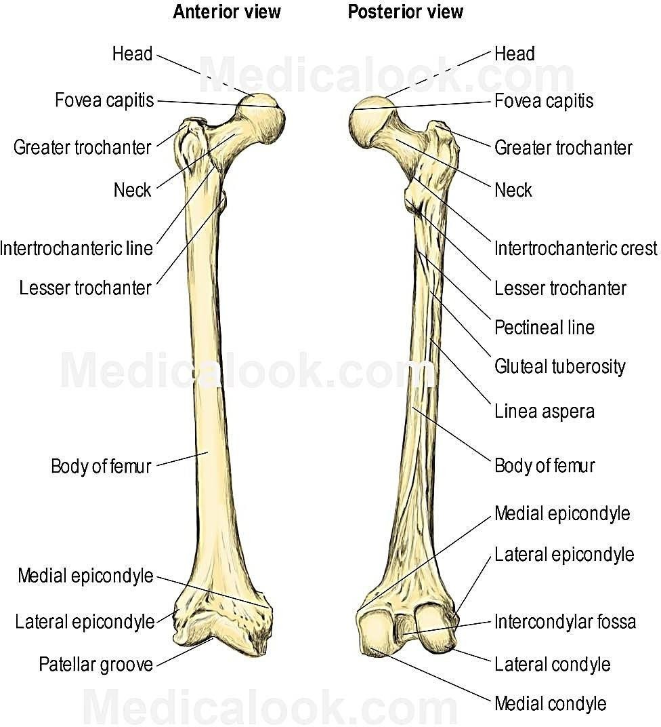
U n i v e r s i t y O f B a s r a h
Al - z a h r a a M e d i c a l C o l l e g e
Ministry of higher Education and Scientific Researches

Slide 14
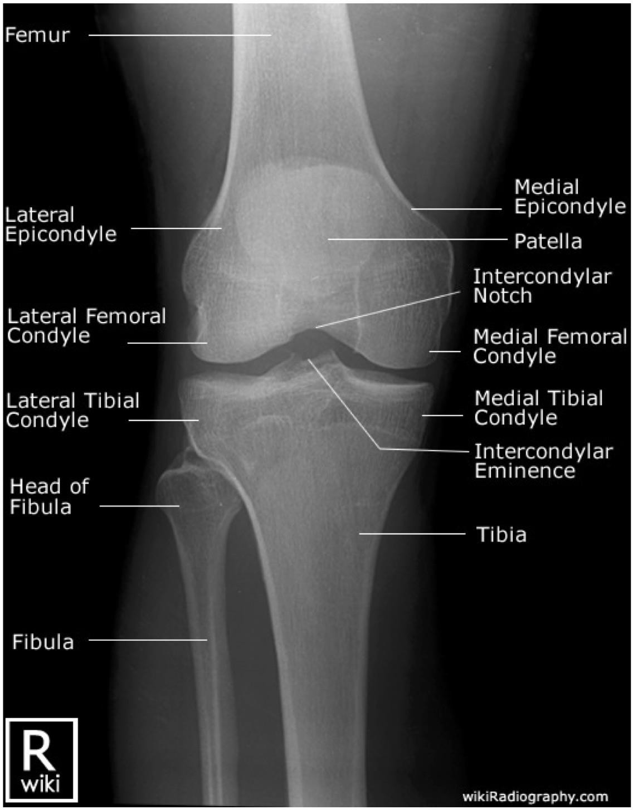
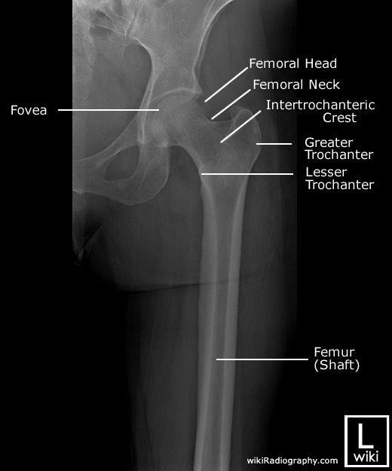
U n i v e r s i t y O f B a s r a h
Al - z a h r a a M e d i c a l C o l l e g e
Ministry of higher Education and Scientific Researches

Slide 15
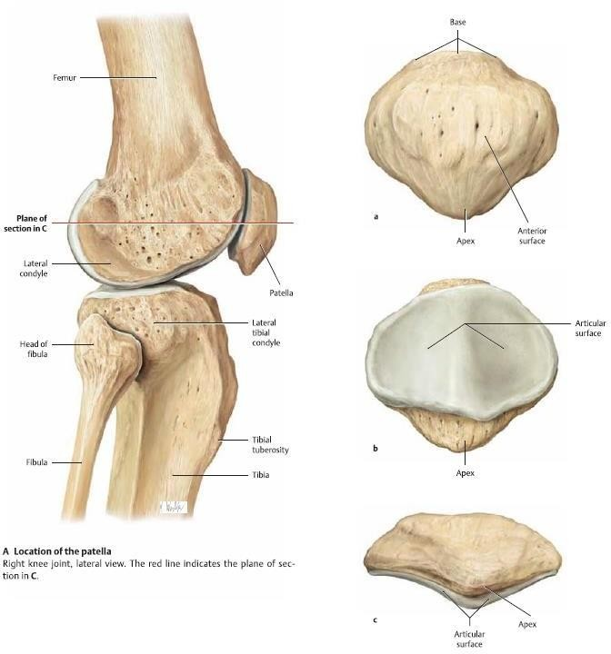
Patella
The patella is a
triangular shaped
sesamoid bone.
It has two surfaces; the rounded, convex anterior surface, and the smooth, articular posterior surface.

Slide 16
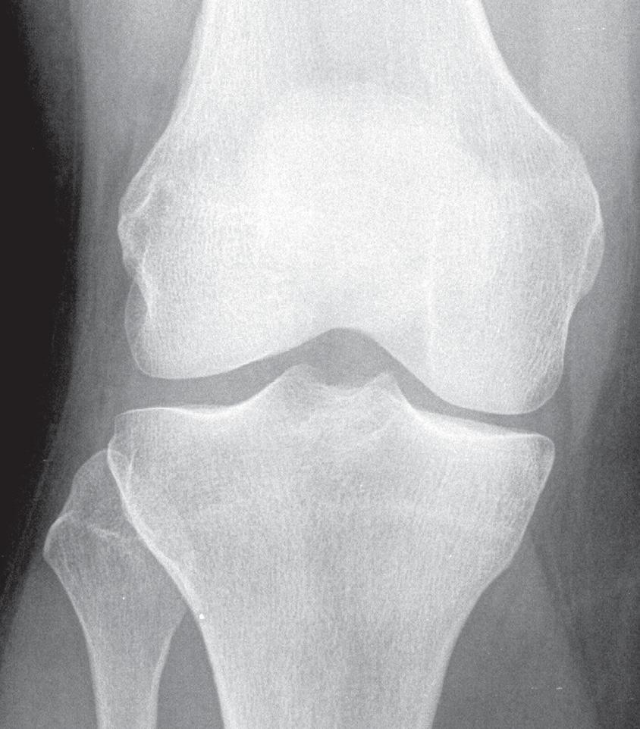
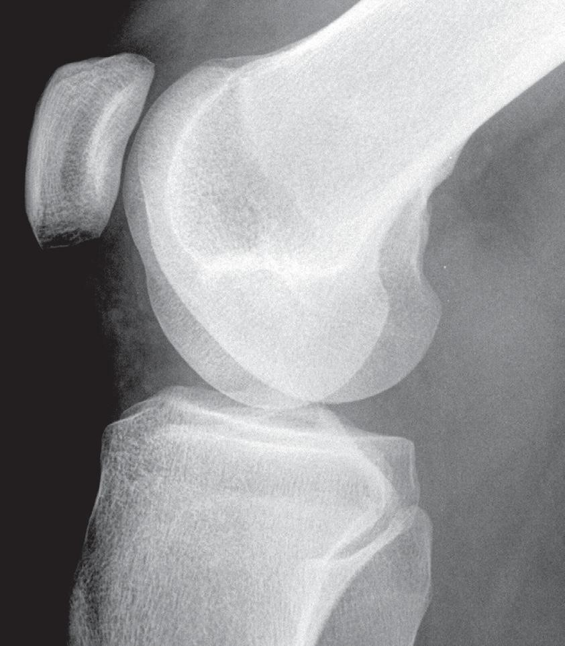
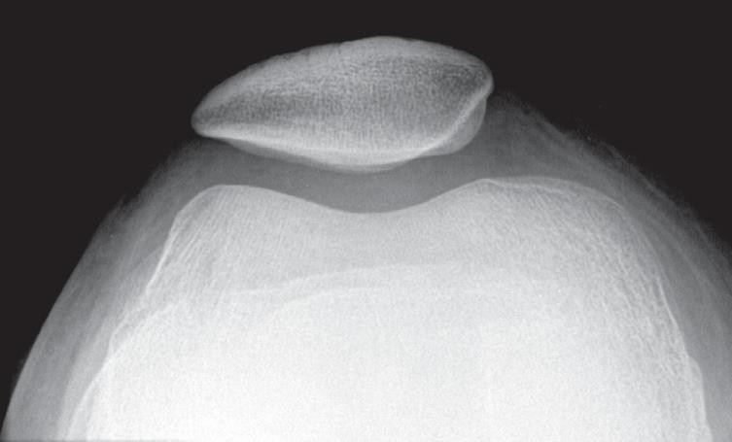
U n i v e r s i t y O f B a s r a h
Al - z a h r a a M e d i c a l C o l l e g e
Ministry of higher Education and Scientific Researches

Slide 17
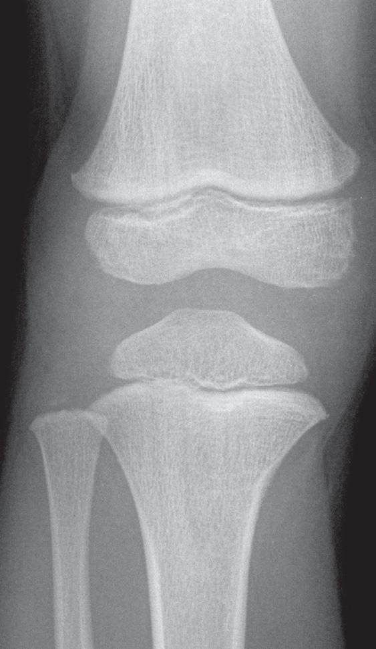
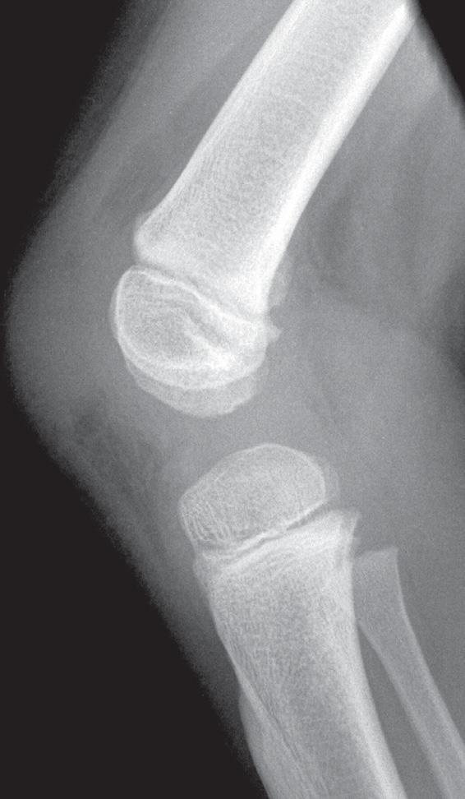
U n i v e r s i t y O f B a s r a h
Al - z a h r a a M e d i c a l C o l l e g e
Ministry of higher Education and Scientific Researches
Where is the patella?

Slide 18
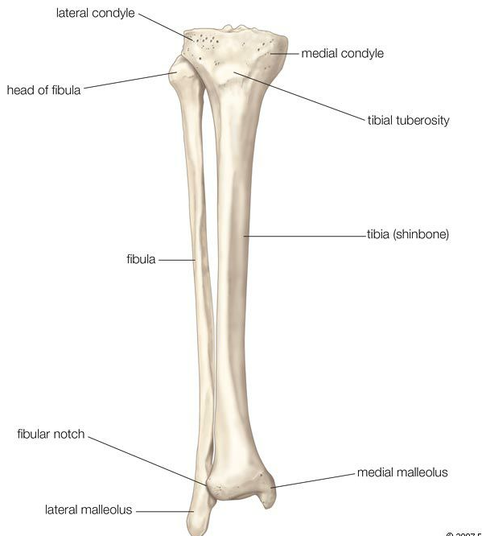
U n i v e r s i t y O f B a s r a h
Al - z a h r a a M e d i c a l C o l l e g e
Ministry of higher Education and Scientific Researches
Tibia
The bone on the medial side of the leg.
It is the weight-bearing bone.
Medial and lateral condyle
Intercondylar emminence
Fibular facet
Tibial tuberosity
Anterior crest (shin)
Medial malleolus
Fibular notch

Slide 19
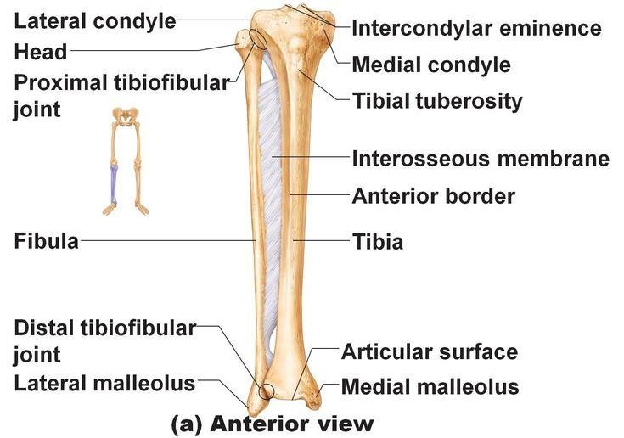
U n i v e r s i t y O f B a s r a h
Al - z a h r a a M e d i c a l C o l l e g e
Ministry of higher Education and Scientific Researches

Slide 20
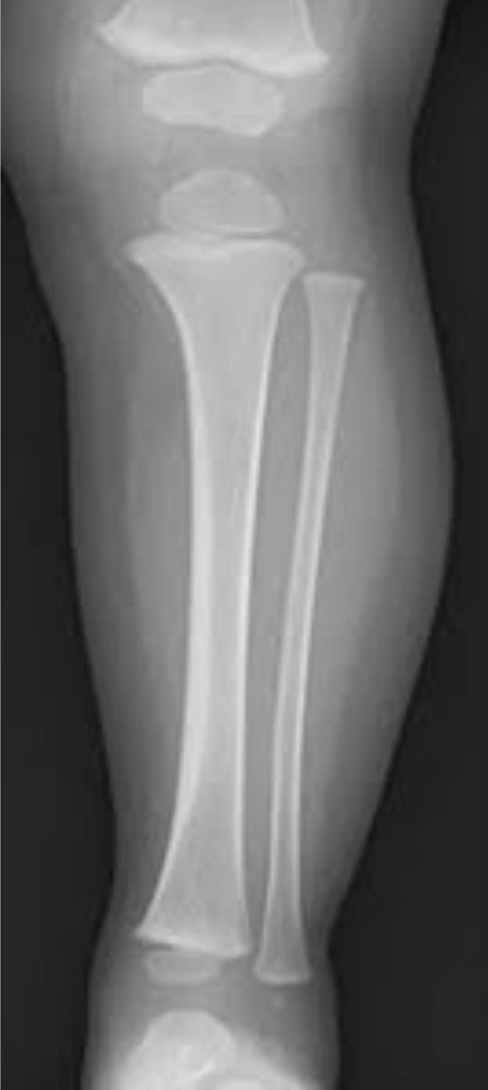

Slide 21
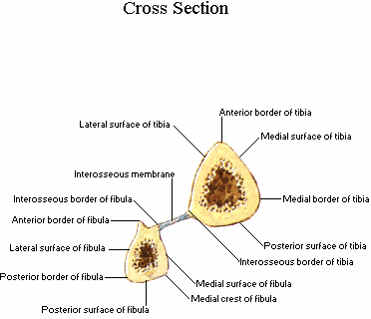

Slide 22
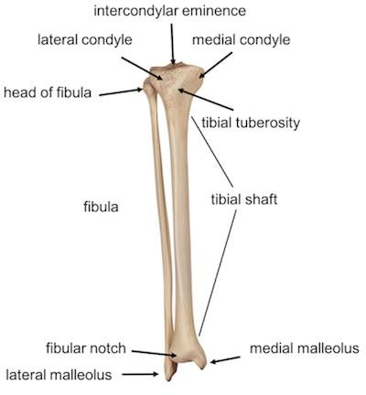
U n i v e r s i t y O f B a s r a h
Al - z a h r a a M e d i c a l C o l l e g e
Ministry of higher Education and Scientific Researches
Fibula
The slender bone on the lateral side of the leg.
Head: articulating with the fibular
facet of the tibia
Shaft or body: long slender portion
Lateral malleolus: articulates with the lateral surface of the talus.

Slide 23
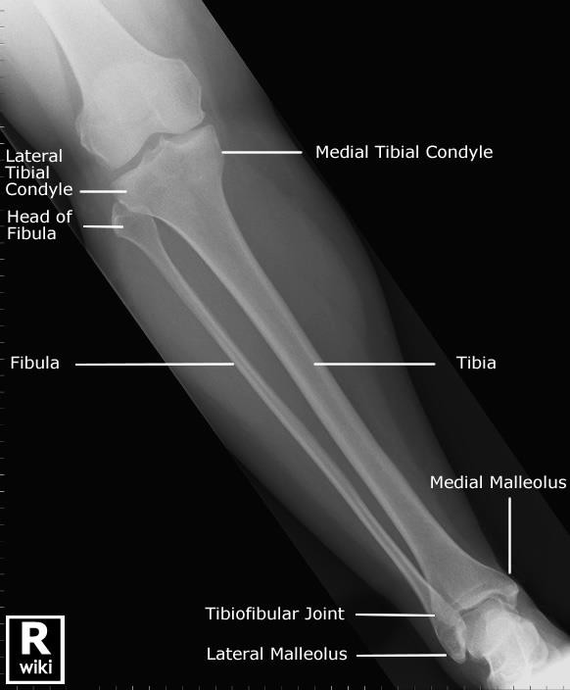

Slide 24
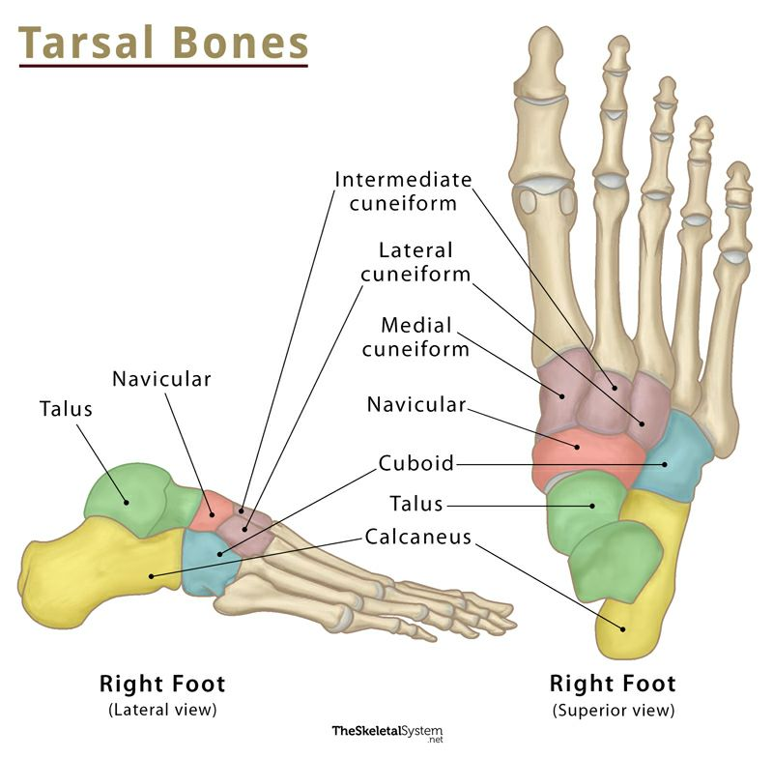
U n i v e r s i t y O f B a s r a h
Al - z a h r a a M e d i c a l C o l l e g e
Ministry of higher Education and Scientific Researches
Foot bones
Tarsus includes:
Calcaneus
Talus
Navicular
Cuboid
Cuneiform bones(3)
Metatarsals(5)
Phalanges(14)

Slide 25
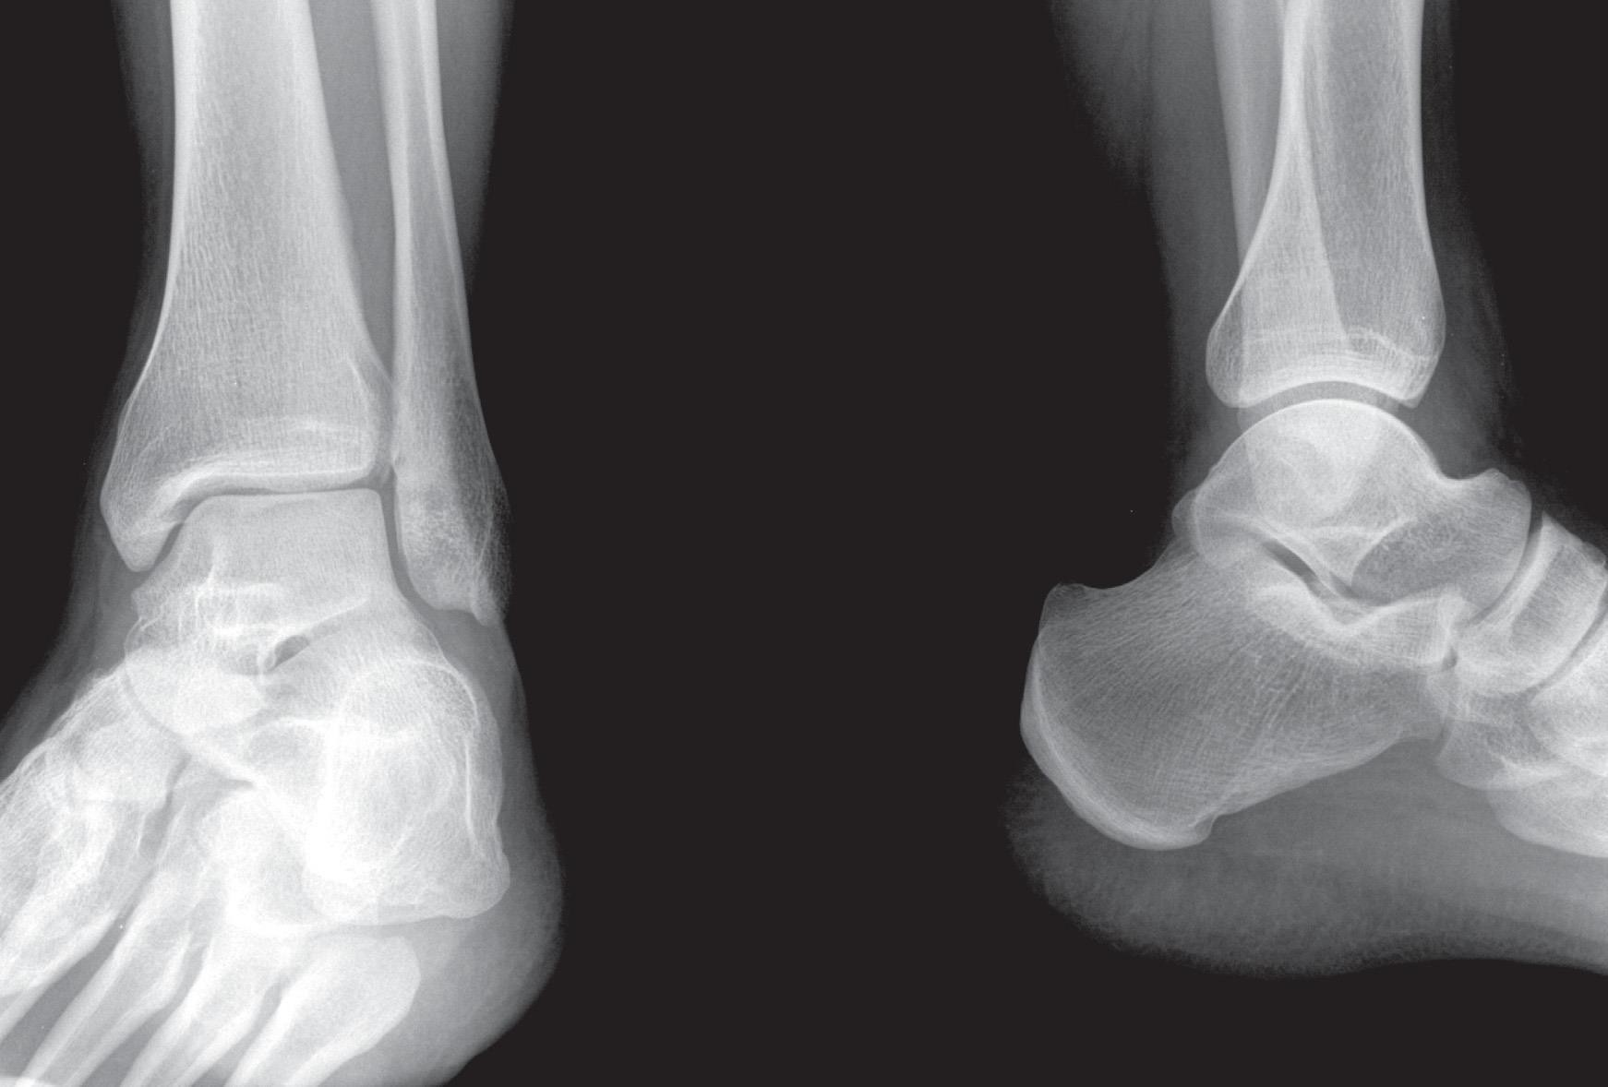
U n i v e r s i t y O f B a s r a h
Al - z a h r a a M e d i c a l C o l l e g e
Ministry of higher Education and Scientific Researches
Ankle joint

Slide 26
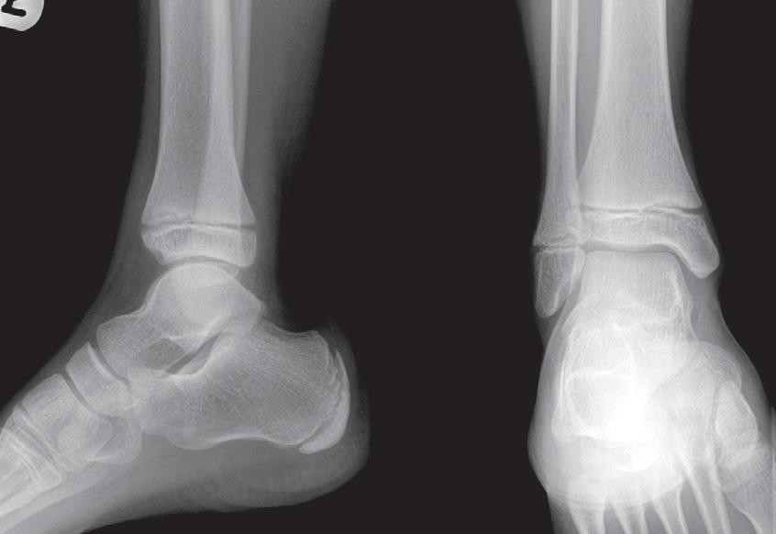
U n i v e r s i t y O f B a s r a h
Al - z a h r a a M e d i c a l C o l l e g e
Ministry of higher Education and Scientific Researches
Child

Slide 27
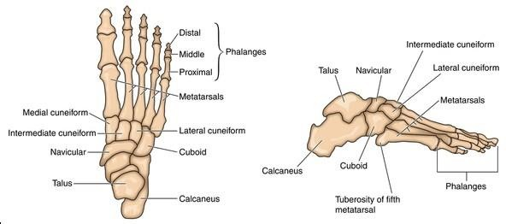
U n i v e r s i t y O f B a s r a h
Al - z a h r a a M e d i c a l C o l l e g e
Ministry of higher Education and Scientific Researches

Slide 28
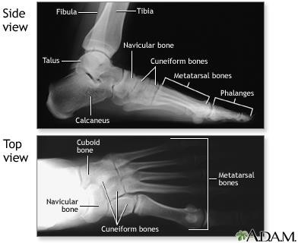

Slide 29
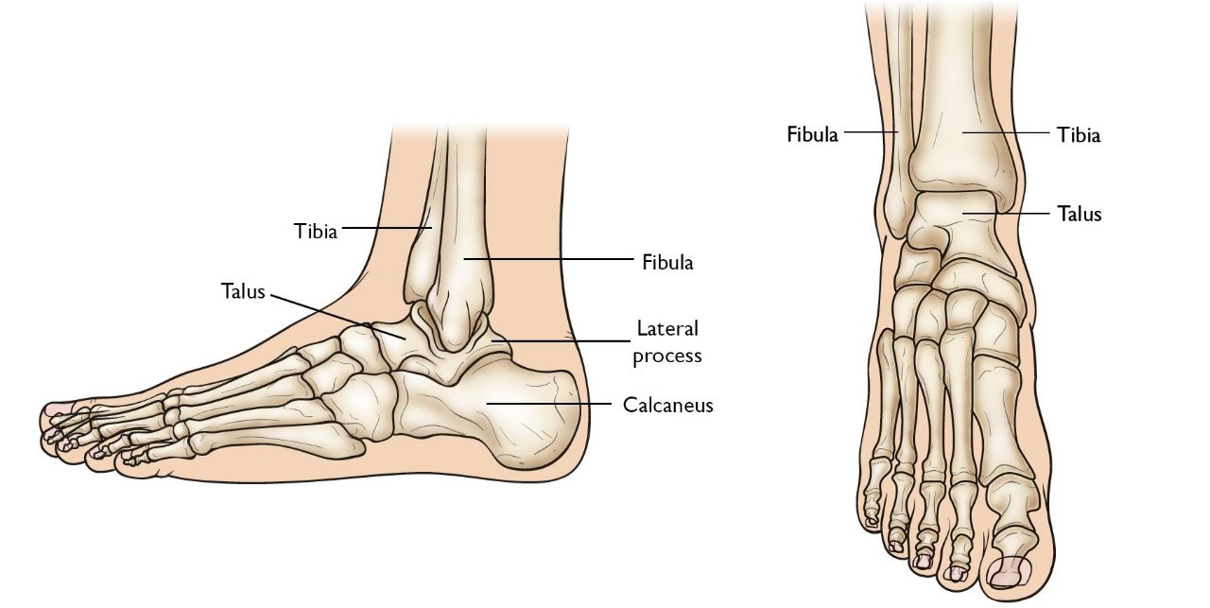
U n i v e r s i t y O f B a s r a h
Al - z a h r a a M e d i c a l C o l l e g e
Ministry of higher Education and Scientific Researches
Talus: Had 3 articular surfaces (share in 3 joints) with:
Tibia and fibula superiorly
Calcaneum inferiorly
Navicular anteriorly

Slide 30
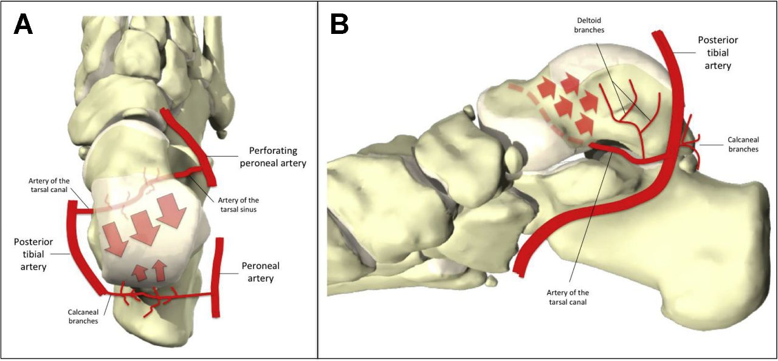
U n i v e r s i t y O f B a s r a h
Al - z a h r a a M e d i c a l C o l l e g e
Ministry of higher Education and Scientific Researches
Talus
Little blood supply……. Avascular necrosis……..
Similar to which bone in the upper limb?
Bad prognosis when fractured

Slide 31
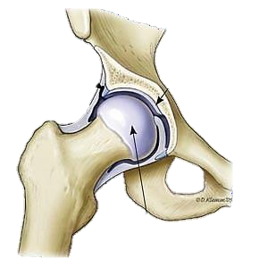
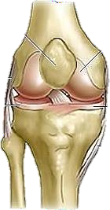
U n i v e r s i t y O f B a s r a h
Al - z a h r a a M e d i c a l C o l l e g e
Ministry of higher Education and Scientific Researches
Hip Joint:
Synovial
Ball and Socket
Knee Joint:
Synovial
Hinge joint

Slide 32
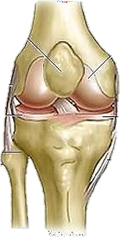
U n i v e r s i t y O f B a s r a h
Al - z a h r a a M e d i c a l C o l l e g e
Ministry of higher Education and Scientific Researches
Superior Tibiofibular :
Synovial
Plane
Inferior tibiofibular:
fibrous joint
Syndesmotic

Slide 33
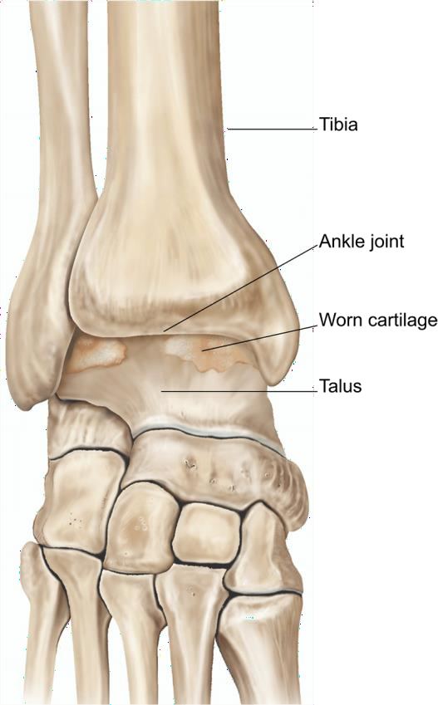
U n i v e r s i t y O f B a s r a h
Al - z a h r a a M e d i c a l C o l l e g e
Ministry of higher Education and Scientific Researches
Ankle Joint
Synovial
Hinge

Slide 34
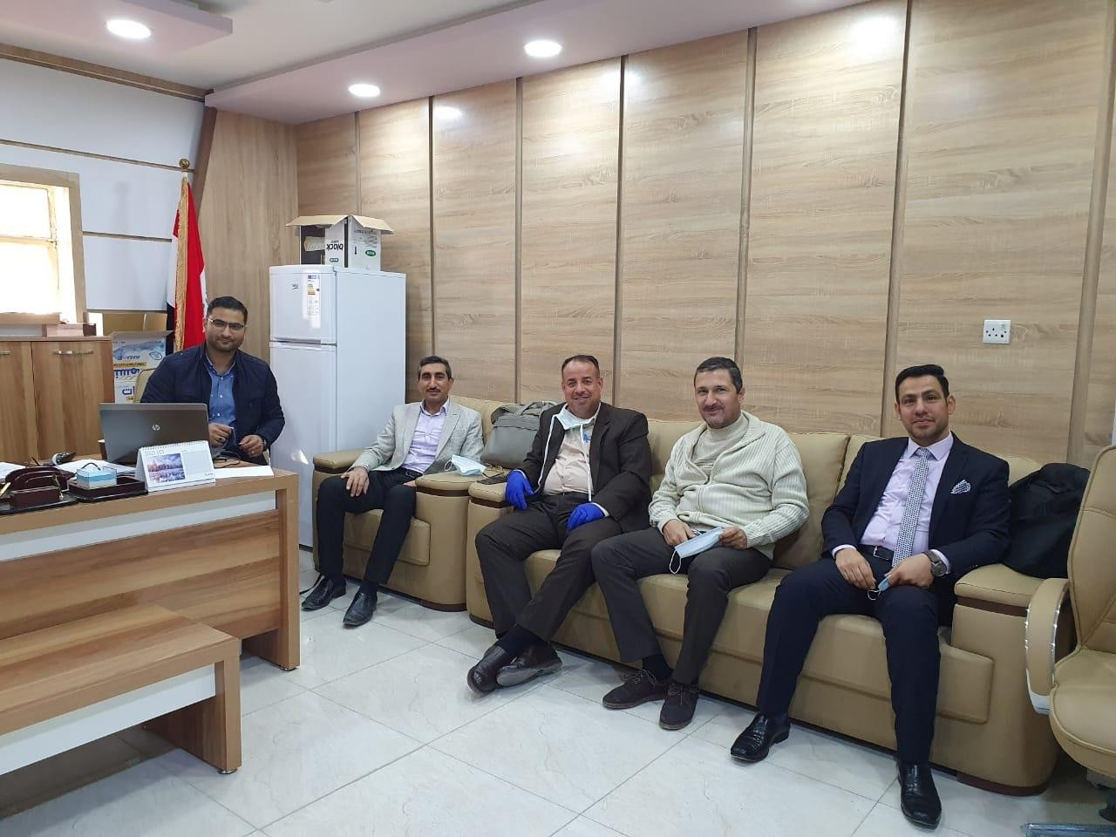
33

